Slide 1
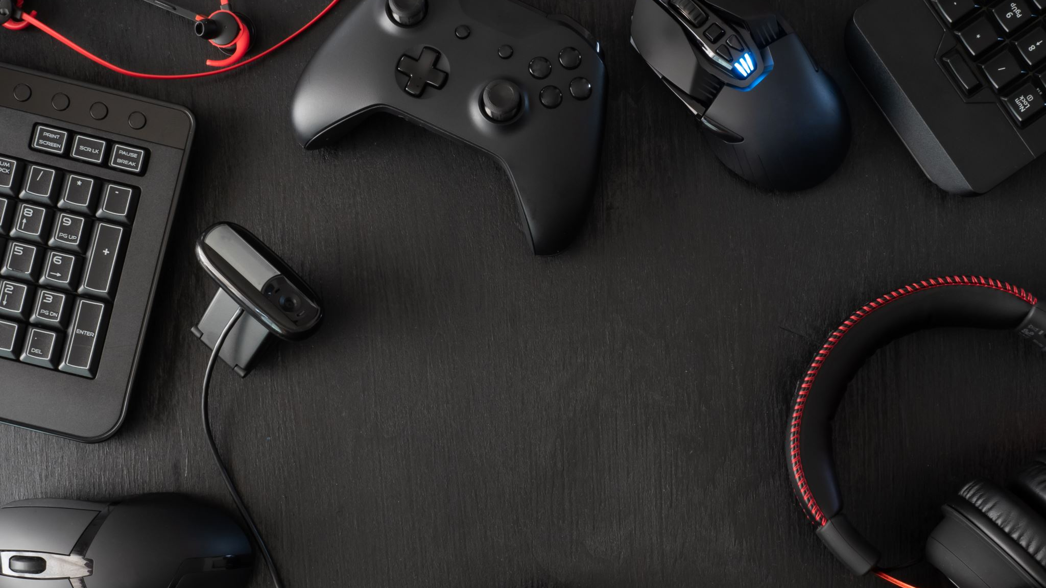
The Game Site
By Andrey Owen, Brandon Cooper, Logan Poe, Prosper Jibunor

Slide 2
Revised Idea

Slide 3
Golden Pitch Canvas

Slide 4

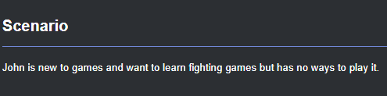
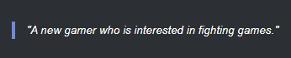
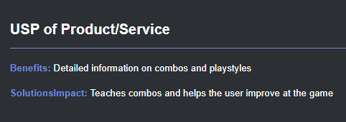
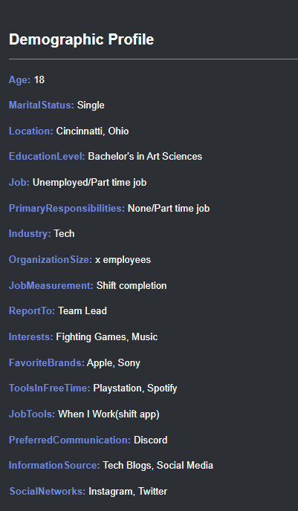
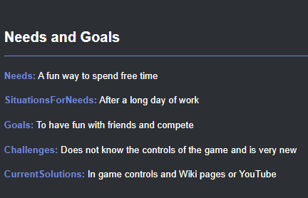
Customer Persona – New Gamer

Slide 5
New Gamer - Interviews

Slide 6
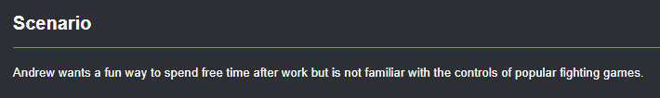

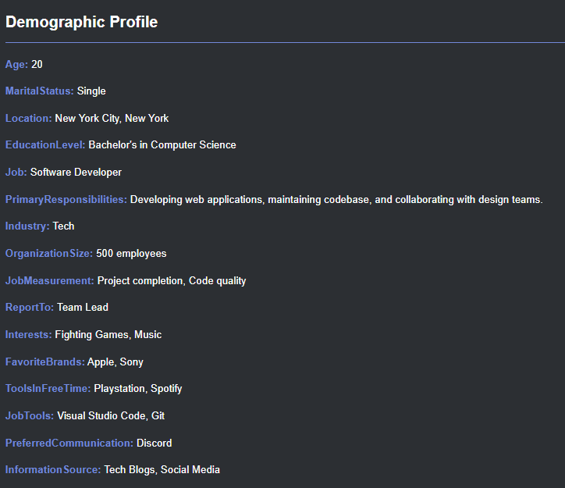
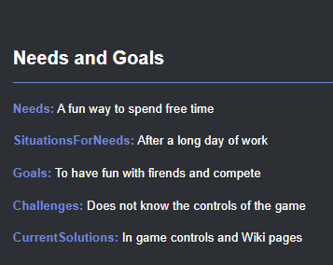
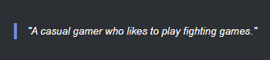
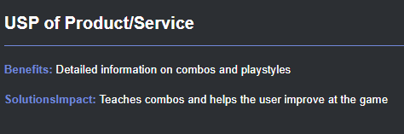
Customer Persona – Casual Gamer

Slide 7
Casual Gamer - Interviews

Slide 8

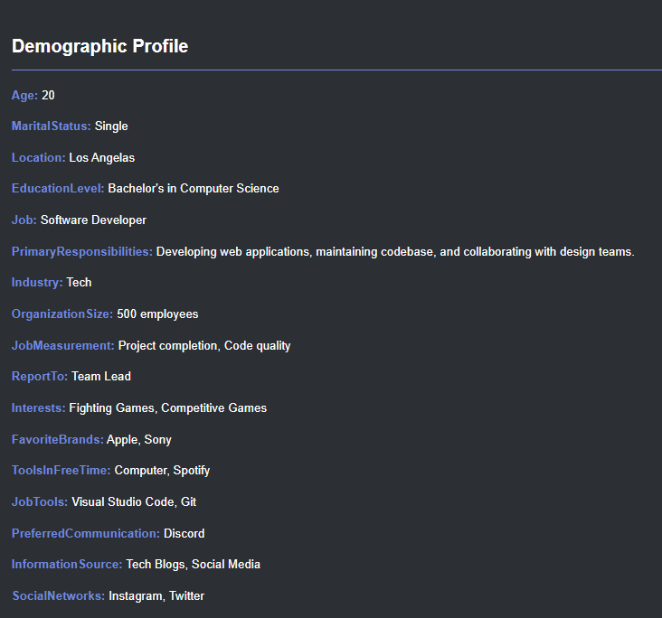
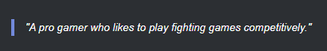
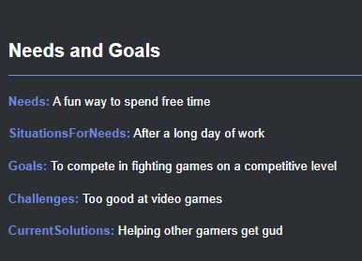
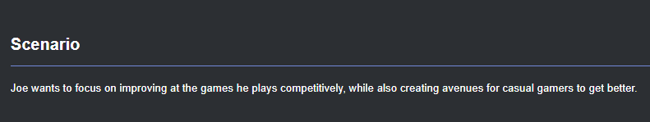
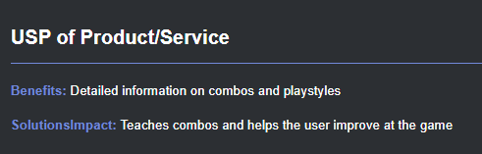
Customer Persona – Pro Gamer

Slide 9
Pro Gamer - Interviews

Slide 10

Value Proposition - New Gamer
Pains:
Little experience,
Little to not skill,
Doesn't know controls
Pain relievers:
Provides controls for a variety of fighting games and platforms
Product:
The Game Site
Process: Fighting games
Gain creators:
A place to find controls
Gains:
Ability to learn controls,
A place to find guidance

Slide 11
Value Proposition - Causal Gamer
Pains:
Plays casually but wishes to improve,
Struggles against
Experienced
opponents
Pain relievers:
Provides advanced combos for a variety of fighting games and platforms
Product:
The Game Site
Process: Fighting games
Gain creators:
A place to find advanced combos
Gains:
Ability to learn better combos, a place to learn

Slide 12
Value Proposition - Pro Gamer
Pains:
Wants to improve,
Can't share experiences well
Pain relievers:
Provides the avenues to share their experience with new to pro gamers
Product:
The Game Site
Process: Fighting games
Gain creators:
Ability to collaborate
Gains:
Ability to share their experience and possibly learn from other pros

Slide 13
The Business Model Canvas – New Gamer
Key partners: Pro gamers
Key activities: Interest in fighting games
Key resources: control guides for fighting games
Value proposition: a one stop site for fighting games guides
Customer relationships: Pro gamers creating accessible sites
Customer segments: Attempts to serve, new, casual, and pro gamers
Channels: User-driven content
Cost structure: Value-driven
Revenue streams: Advertising

Slide 14
The Business Model Canvas – Casual Gamer
Key partners: Pro gamers
Key activities: Interest in improving at fighting games
Key resources: control guides for fighting games
Value proposition: a one stop site for fighting games guides
Customer relationships: Pro gamers creating accessible sites
Customer segments: Attempts to serve, new, casual, and pro gamers
Channels: User-driven content
Cost structure: Value-driven
Revenue streams: Advertising

Slide 15
The Business Model Canvas – Pro Gamer
Key partners: Pro gamers
Key activities: Interest in sharing experience of fighting games
Key resources: control guides for fighting games
Value proposition: a one stop site for fighting games guides
Customer relationships: Pro gamers crating accessible sites
Customer segments: Attempts to serve, new, casual, and pro gamers
Channels: User-driven content
Cost structure: Value-driven
Revenue streams: Advertising

Slide 16
Competitor analysis - IGN
Pros
• Has guides for all the most popular games not just fighting games.
• Guides can have contributions from the community. As can our site.
• IGN creates their own video guides for some games. Our videos are all community sourced.
• Lots of articles on gaming news. We do not have articles (yet).
Cons
• Lots of advertisements. Our sites will not have standard advertisements.
• Majority of site lacks polish. Our site will be perfect.
• IGN has too broad of a focus. We plan to target specific types of individuals.

Slide 17
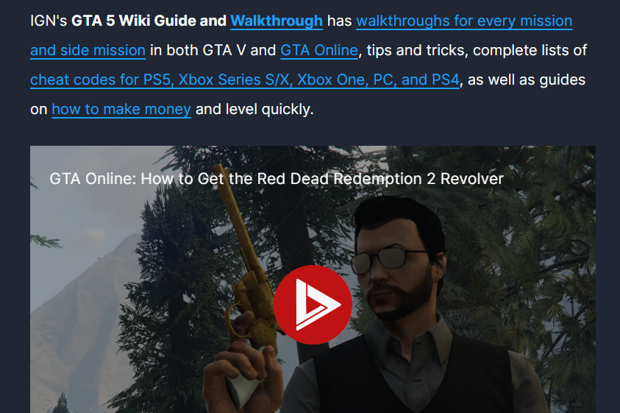
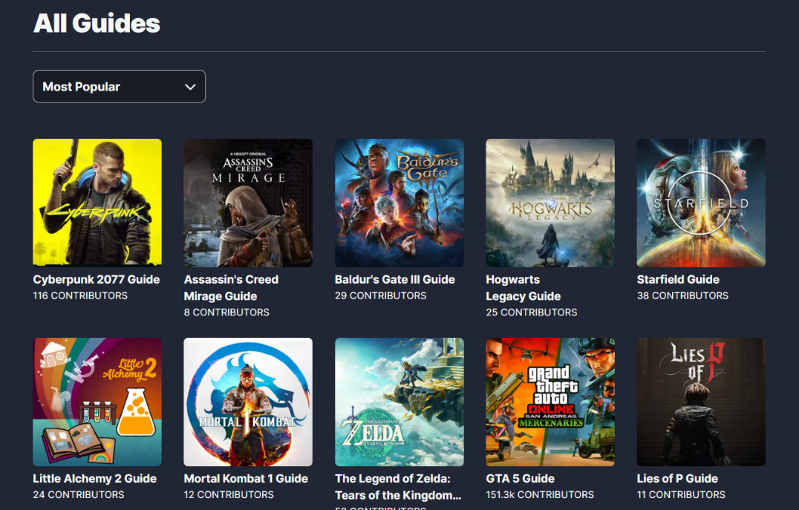
IGN - Site

Slide 18
Competitor analysis - KOTAKU
Pros
• Has tips and guides but they are all in the form of articles.
• Covers gaming news. We do not outside of new strategies.
• Has game reviews. We do not review games.
Cons
• Lots of advertisements. Our sites will not have standard advertisements.
• Lacks user generated content.
• Does not cover controls. Our site will.

Slide 19

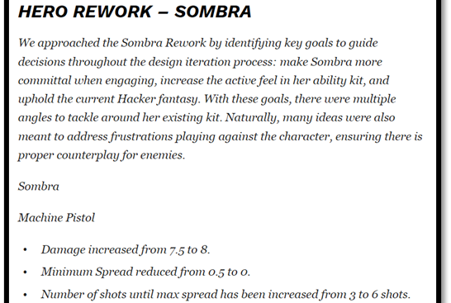
KOTAKU - Site

Slide 20
Competitor analysis - YouTube
Pros
• Very clean interface. Our site will also be clean.
• Videos for any game imaginable.
• Limited number of advertisements. Our site will also have very few.
• Everything is user generated.
Cons
• This site does not have information in text format.
• The type of videos on the site are very broad.
• Controls and information may not be covered in a way that helps a user.

Slide 21
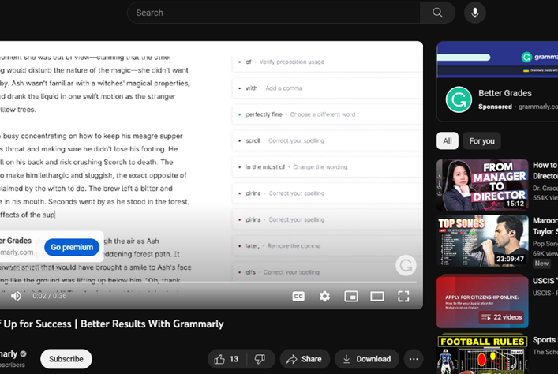
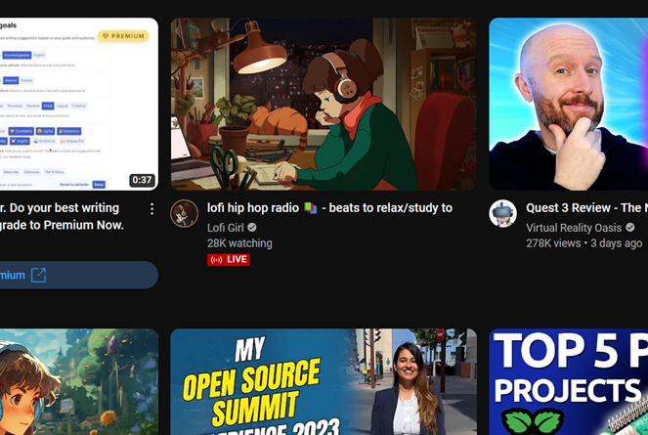
YouTube - Site

Slide 22
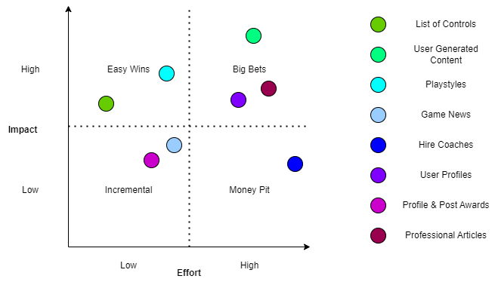
Impact VS Effort Feature Map

Slide 23
Feature List Timeline

Slide 24
SWOT Analysis

Slide 25
PESTEL Analysis

Slide 26
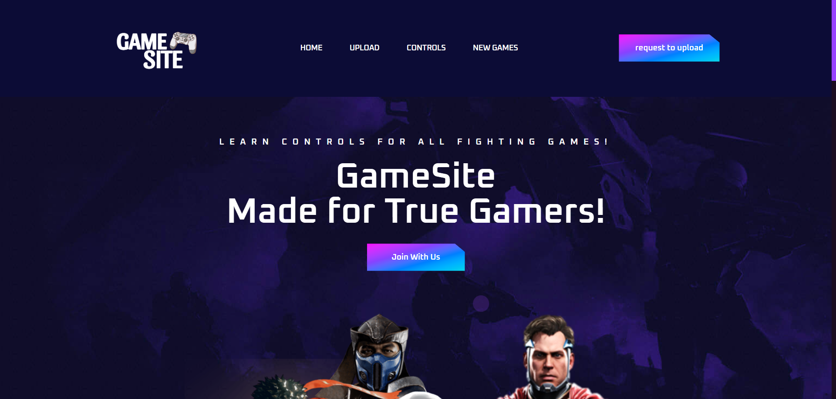
User Interface

Slide 27
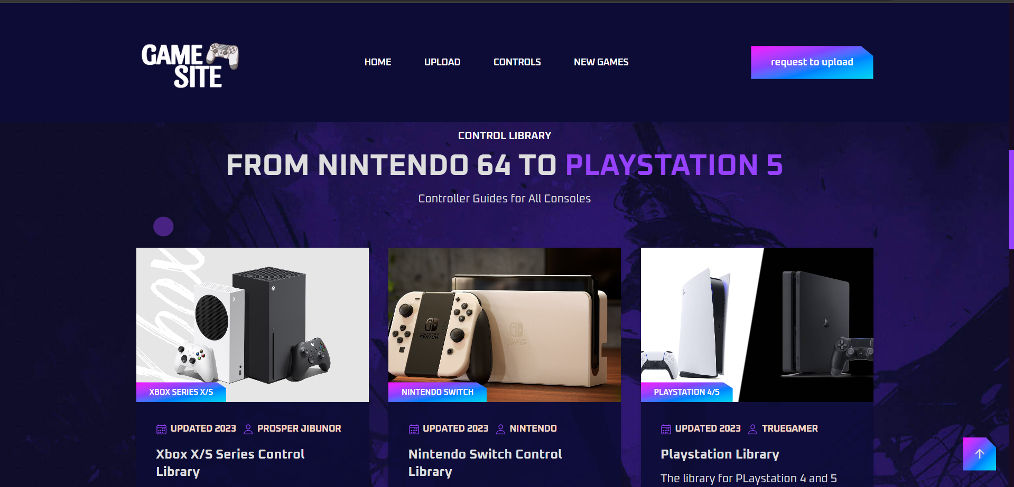

Slide 28
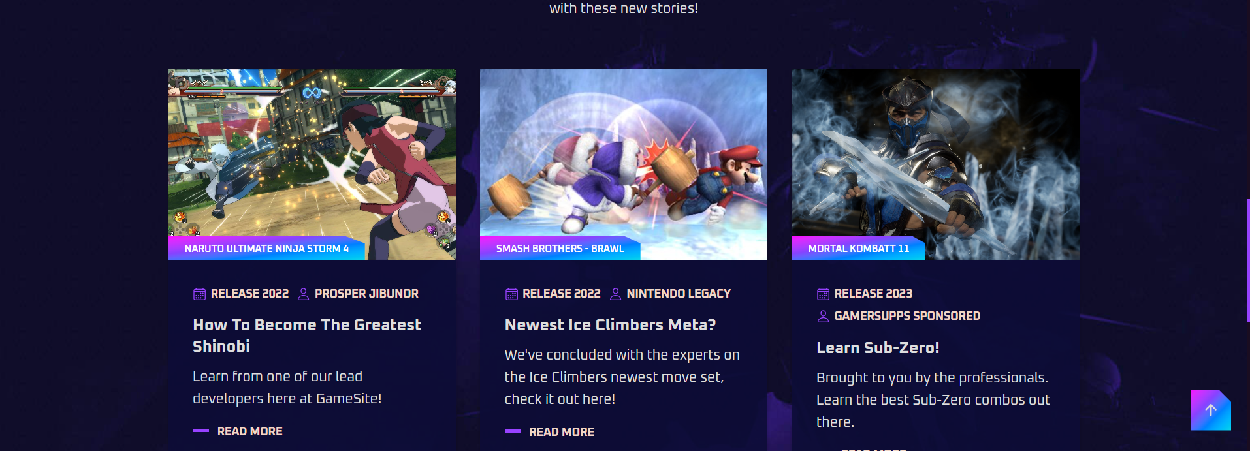

Slide 29
